Slide 1
Architecture of Enterprise Applications 16 Neo4J & Graph Computing
Haopeng Chen
REliable, INtelligent and Scalable Systems Group (REINS)
Shanghai Jiao Tong University
Shanghai, China
http://reins.se.sjtu.edu.cn/~chenhp
e-mail: chen-hp@sjtu.edu.cn

Slide 2
Contents and Objectives
Contents
Neo4J
Graph Database
Options for Storing Connected Data
Data Modeling with Graphs
Building a Graph Database Application
Graph Database Internals
Objectives
能够根据数据特性和数据访问模式，识别适合图数据库存储的数据，设计并实现其在图数据库中的存储和访问方案

Slide 3
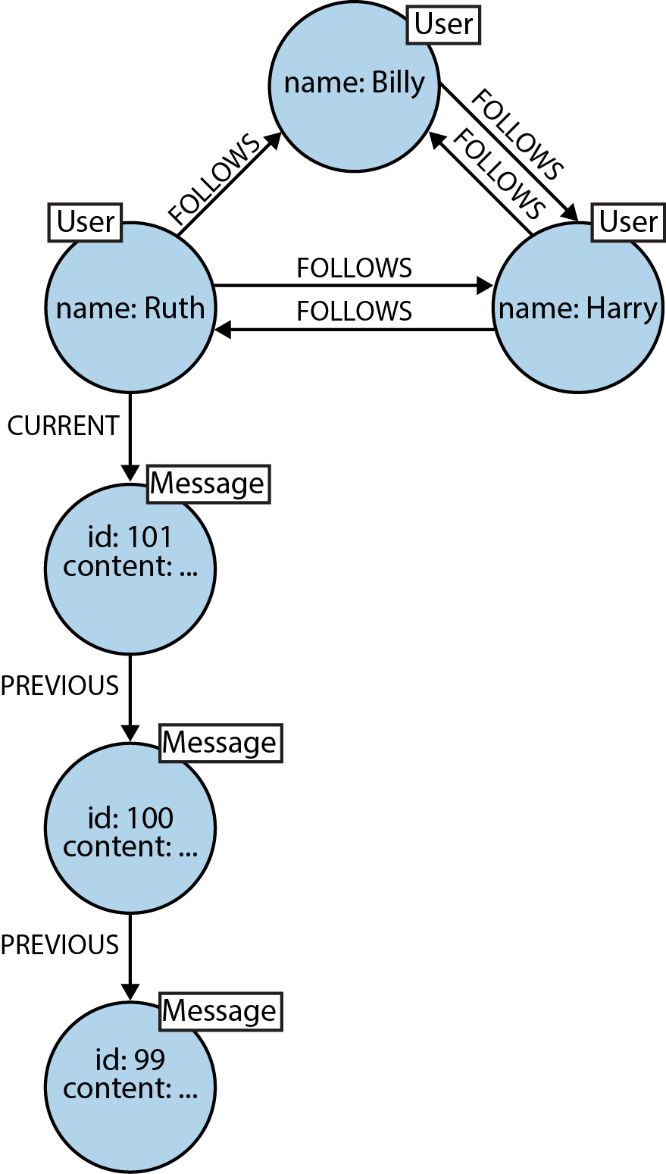
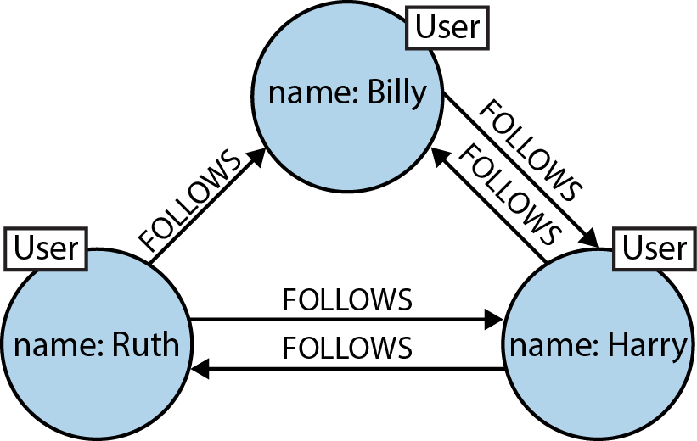
What is a Graph?
Formally, a graph is just a collection of vertices and edges
or, in less intimidating language, a set of nodes and the relationships that connect them.
Graphs represent entities as nodes and
the ways in which those entities relate to
the world as relationships.

Slide 4
Graph Databases
A graph database management system (henceforth, a graph database) is
an online database management system with Create, Read, Update, and Delete (CRUD) methods that expose a graph data model.
Graph databases are generally built for use with transactional (OLTP) systems.
Accordingly, they are normally optimized for transactional performance, and engineered with transactional integrity and operational availability in mind.
There are two properties of graph databases we should consider when investigating graph database technologies:
The underlying storage
The processing engine

Slide 5
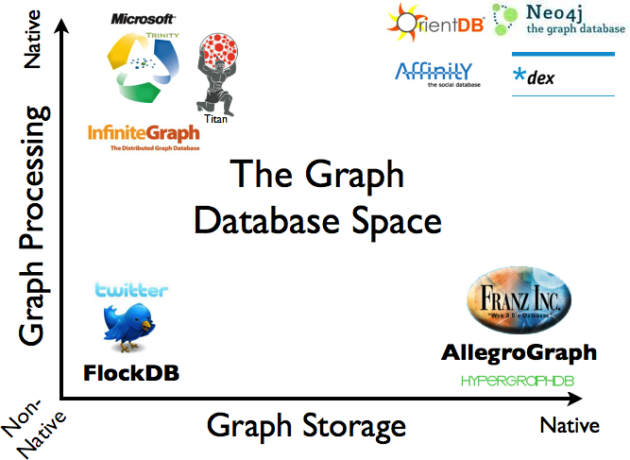
Graph Databases

Slide 6
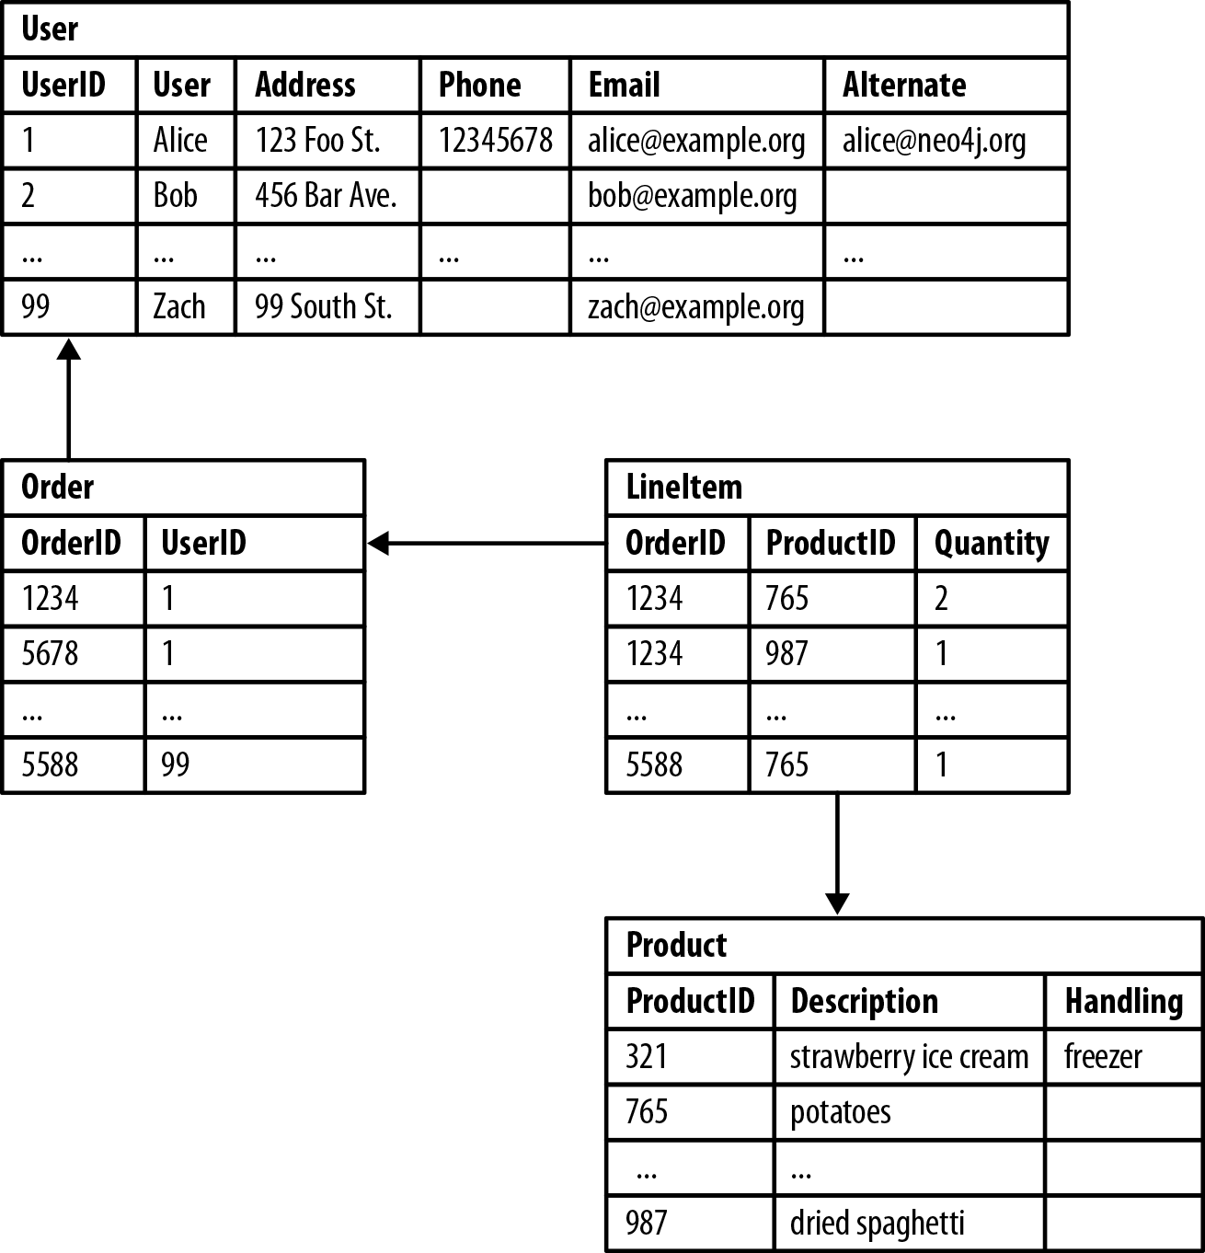
Options for Storing Connected Data
Relational Databases Lack Relationships

Slide 7
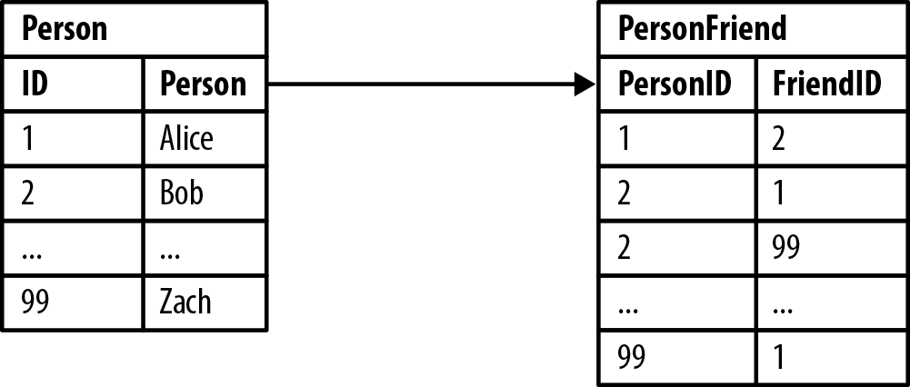
Options for Storing Connected Data
Relational Databases Lack Relationships
Example 1. Bob’s friends
SELECT p1.Person FROM Person p1 JOIN PersonFriend
ON PersonFriend.FriendID = p1.ID
JOIN Person p2
ON PersonFriend.PersonID = p2.ID
WHERE p2.Person = 'Bob’
Example 2-2. Who is friends with Bob?
SELECT p1.Person FROM Person p1 JOIN PersonFriend
ON PersonFriend.PersonID = p1.ID
JOIN Person p2
ON PersonFriend.FriendID = p2.ID
WHERE p2.Person = 'Bob’
Example 3. Alice’s friends-of-friends
SELECT p1.Person AS PERSON,
p2.Person AS FRIEND_OF_FRIEND
FROM PersonFriend pf1 JOIN Person p1
ON pf1.PersonID = p1.ID
JOIN PersonFriend pf2
ON pf2.PersonID = pf1.FriendID
JOIN Person p2
ON pf2.FriendID = p2.ID WHERE p1.Person = 'Alice' AND pf2.FriendID <> p1.ID

Slide 8
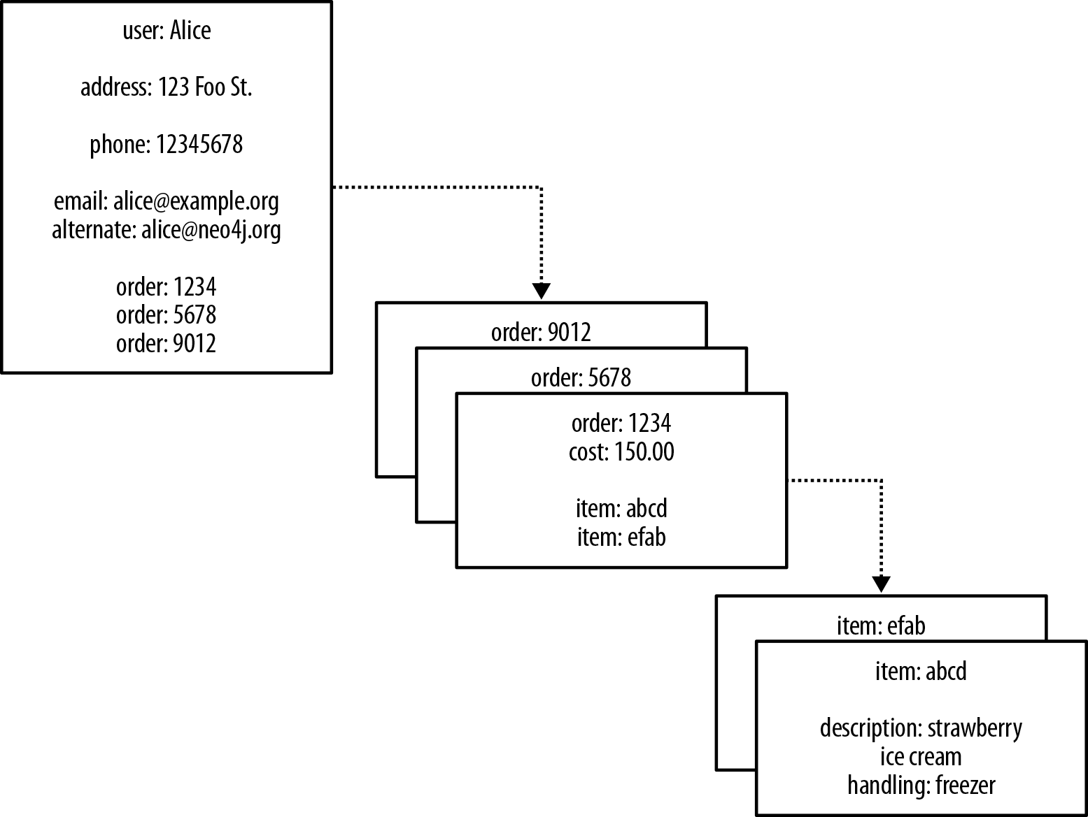
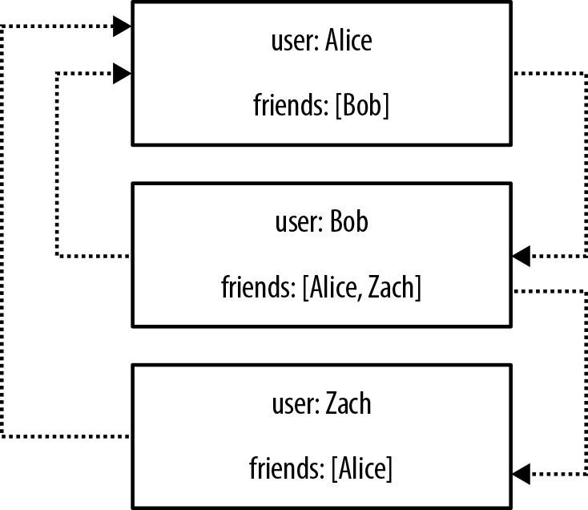
Options for Storing Connected Data
NOSQL Databases Also Lack Relationships

Slide 9
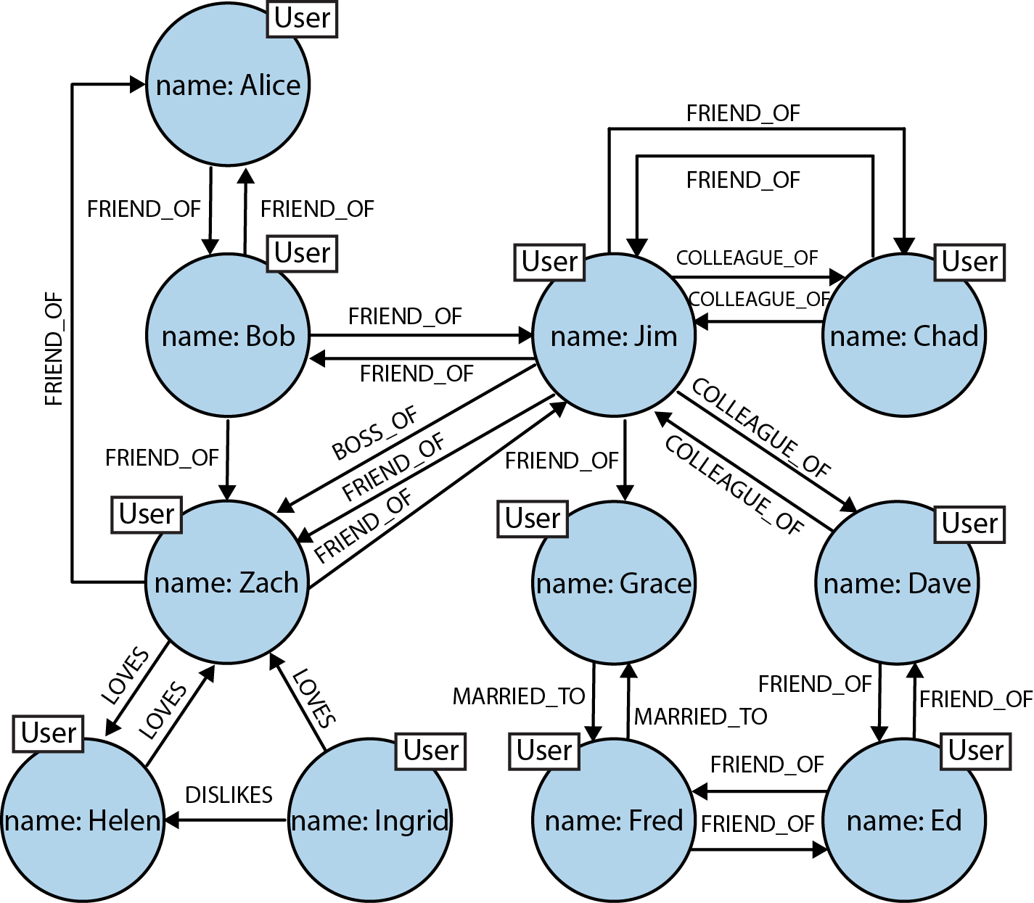
Options for Storing Connected Data
Graph Databases Embrace Relationships

Slide 10
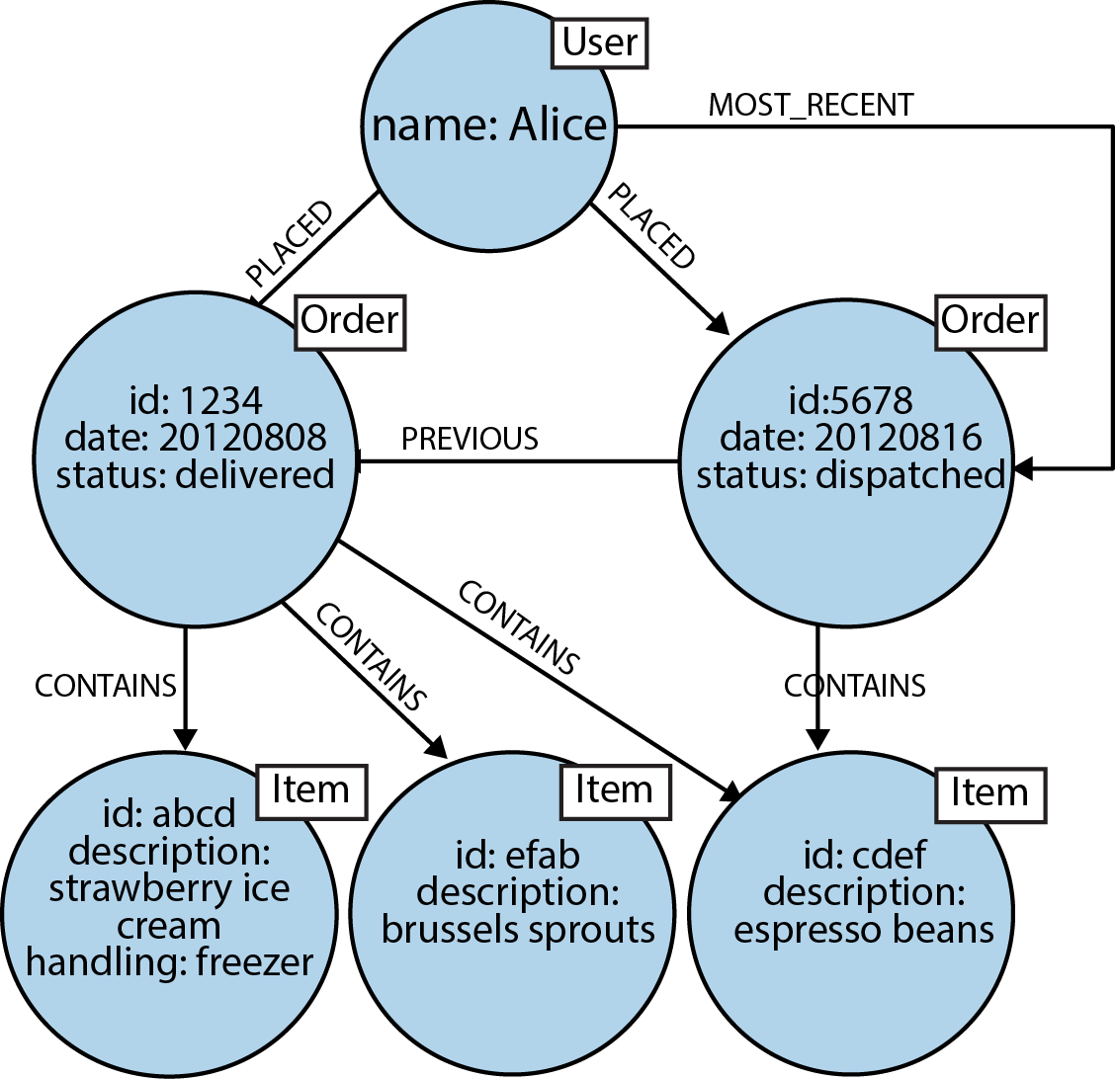
Options for Storing Connected Data
Graph Databases Embrace Relationships

Slide 11
Data Modeling with Graphs
The Labeled Property Graph Model
A labeled property graph is made up of nodes, relationships, properties, and labels.
Nodes contain properties. Think of nodes as documents that store properties in the form of arbitrary key-value pairs. In Neo4j, the keys are strings and the values are the Java string and primitive data types, plus arrays of these types.
Nodes can be tagged with one or more labels. Labels group nodes together, and indicate the roles they play within the dataset.
Relationships connect nodes and structure the graph. A relationship always has a direction, a single name, and a start node and an end node—there are no dangling relationships. Together, a relationship’s direction and name add semantic clarity to the structuring of nodes.

Slide 12
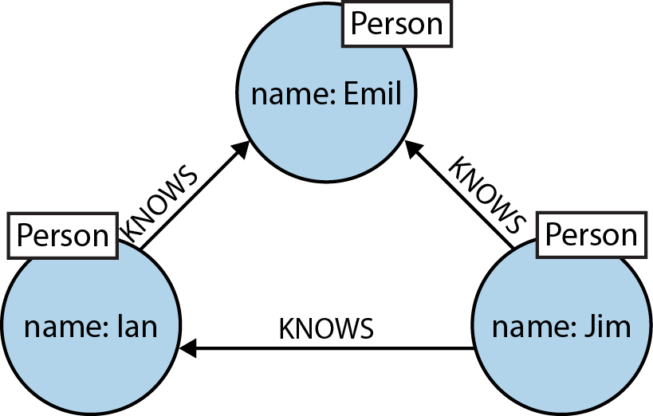
Data Modeling with Graphs
Querying Graphs: Cypher
Cypher is an expressive (yet compact) graph database query language.
Here’s the equivalent ASCII art representation in Cypher:
(emil:Person {name:'Emil'}) <-[:KNOWS]-(jim:Person {name:'Jim'}) -[:KNOWS]->(ian:Person {name:'Ian'}) -[:KNOWS]->(emil)

Slide 13
Data Modeling with Graphs
Querying Graphs: Cypher
Cypher is an expressive (yet compact) graph database query language.
Match:
MATCH (a:Person)-[:KNOWS]->(b)-[:KNOWS]->(c), (a)-[:KNOWS]->(c)
WHERE a.name = 'Jim' RETURN b, c

Slide 14
Data Modeling with Graphs
Querying Graphs: Cypher
The other clauses we can use in a Cypher query include:
WHERE
Provides criteria for filtering pattern matching results.
CREATE and CREATE UNIQUE
Create nodes and relationships.
MERGE
Ensures that the supplied pattern exists in the graph, either by reusing existing nodes and relationships that match the supplied predicates, or by creating new nodes and relationships.
DELETE
Removes nodes, relationships, and properties.
SET
Sets property values
FOREACH
Performs an updating action for each element in a list.
UNION
Merges results from two or more queries.
WITH
Chains subsequent query parts and forwards results from one to the next. Similar to piping commands in Unix.
START
Specifies one or more explicit starting points—nodes or relationships—in the graph.

Slide 15
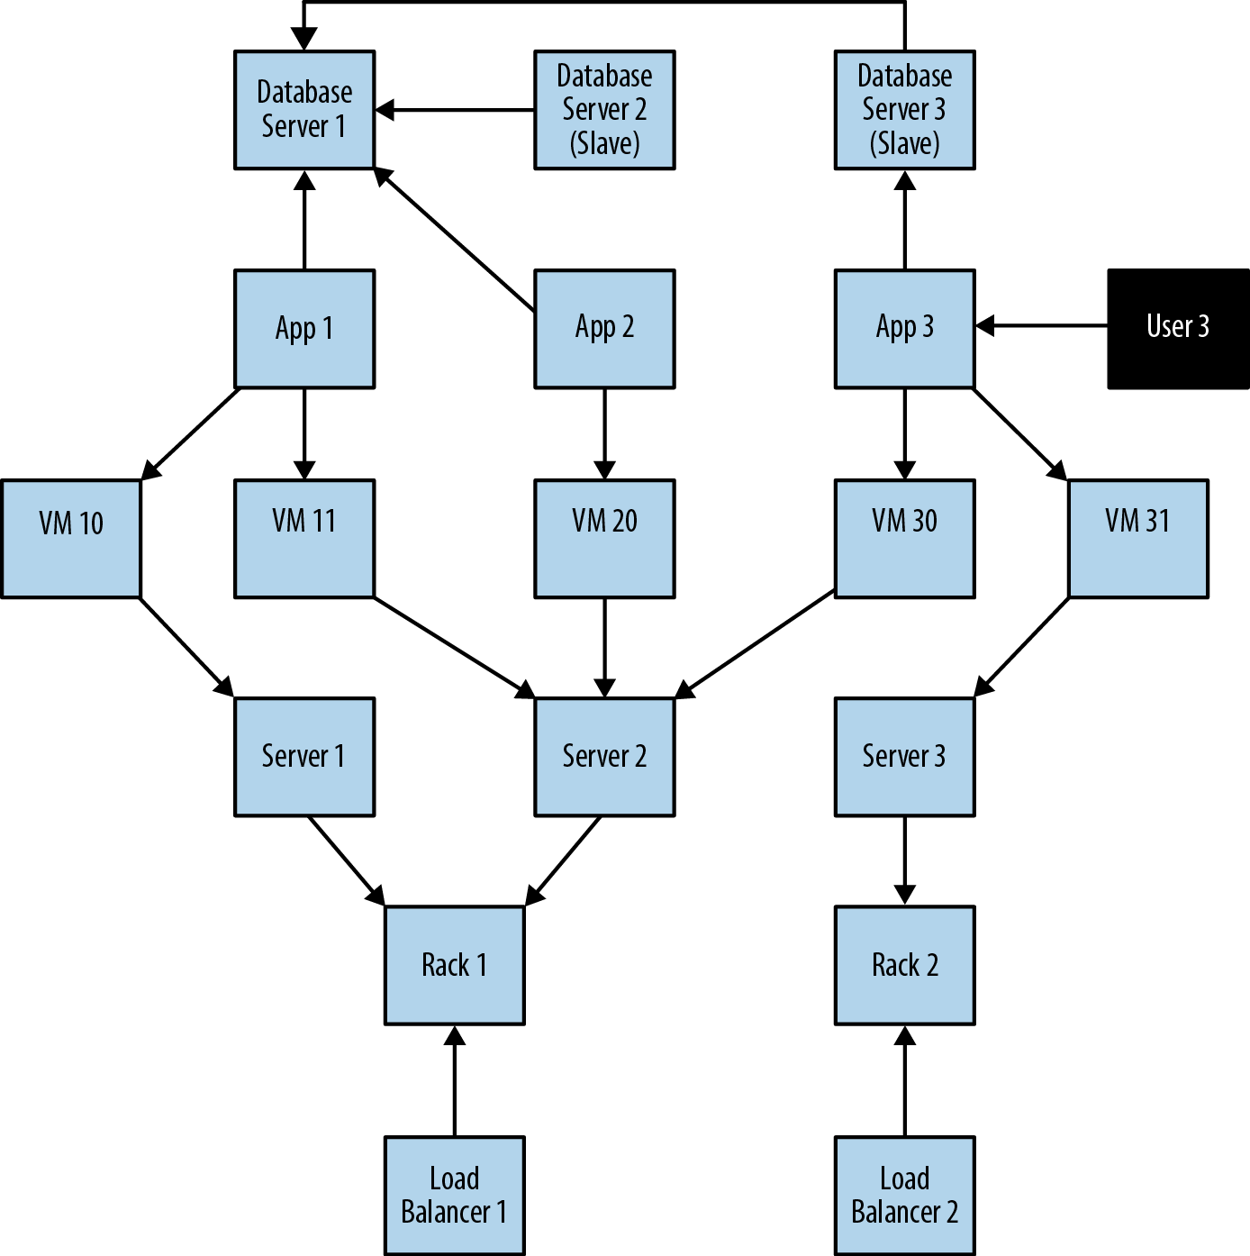
Data Modeling with Graphs
A Comparison of Relational and Graph Modeling
To facilitate this comparison, we’ll examine a simple data center management domain.

Slide 16
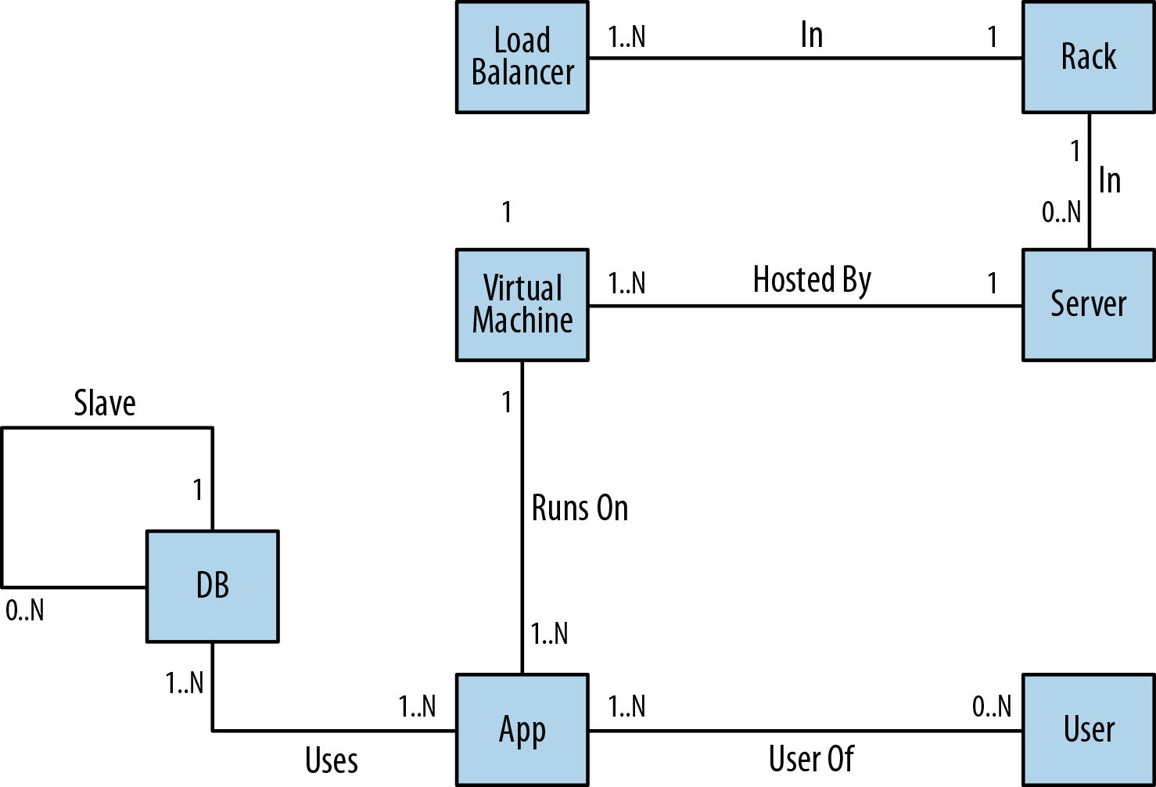
Data Modeling with Graphs
Relational Modeling in a Systems Management Domain

Slide 17
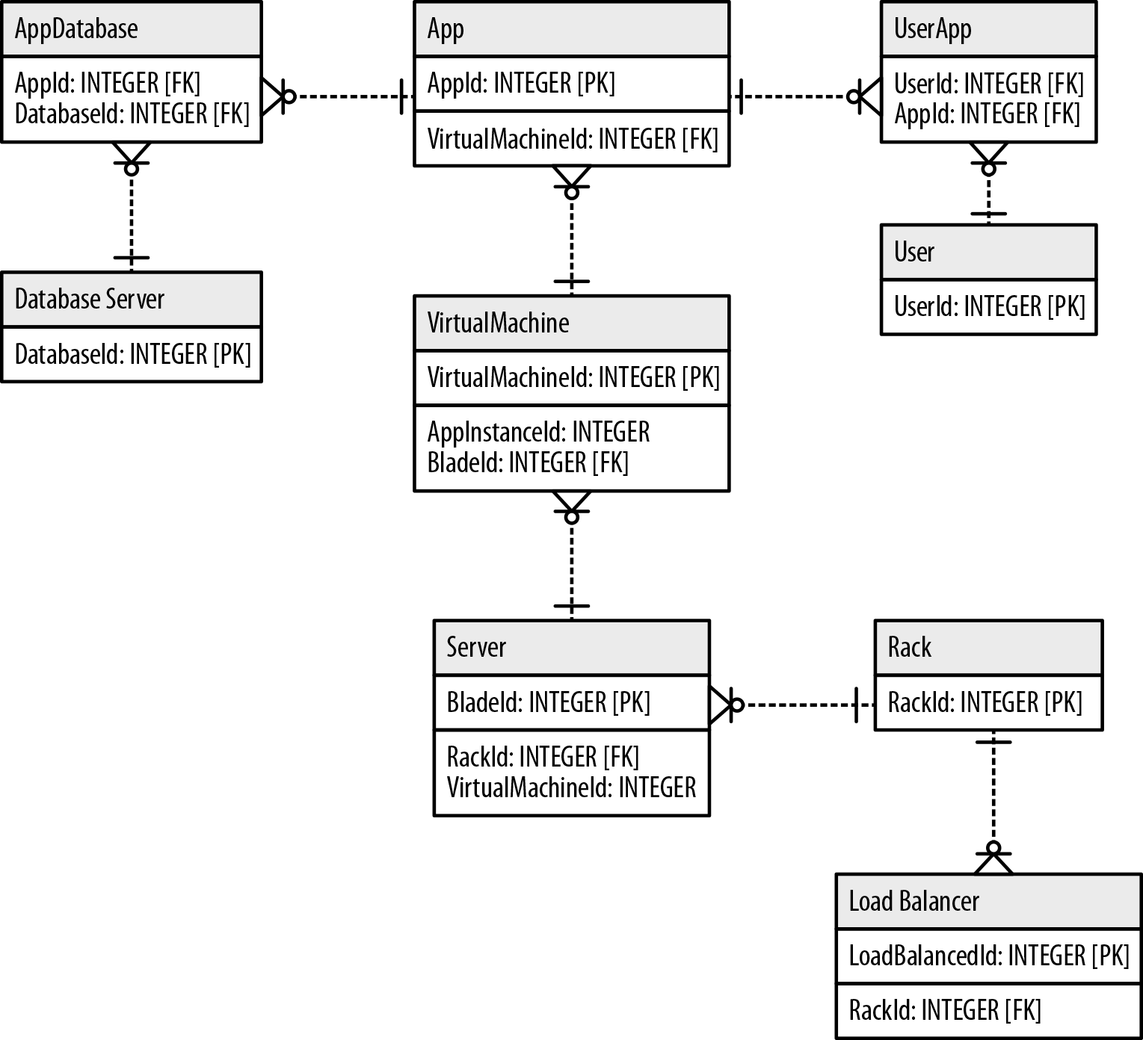
Data Modeling with Graphs
Relational Modeling in a Systems Management Domain

Slide 18
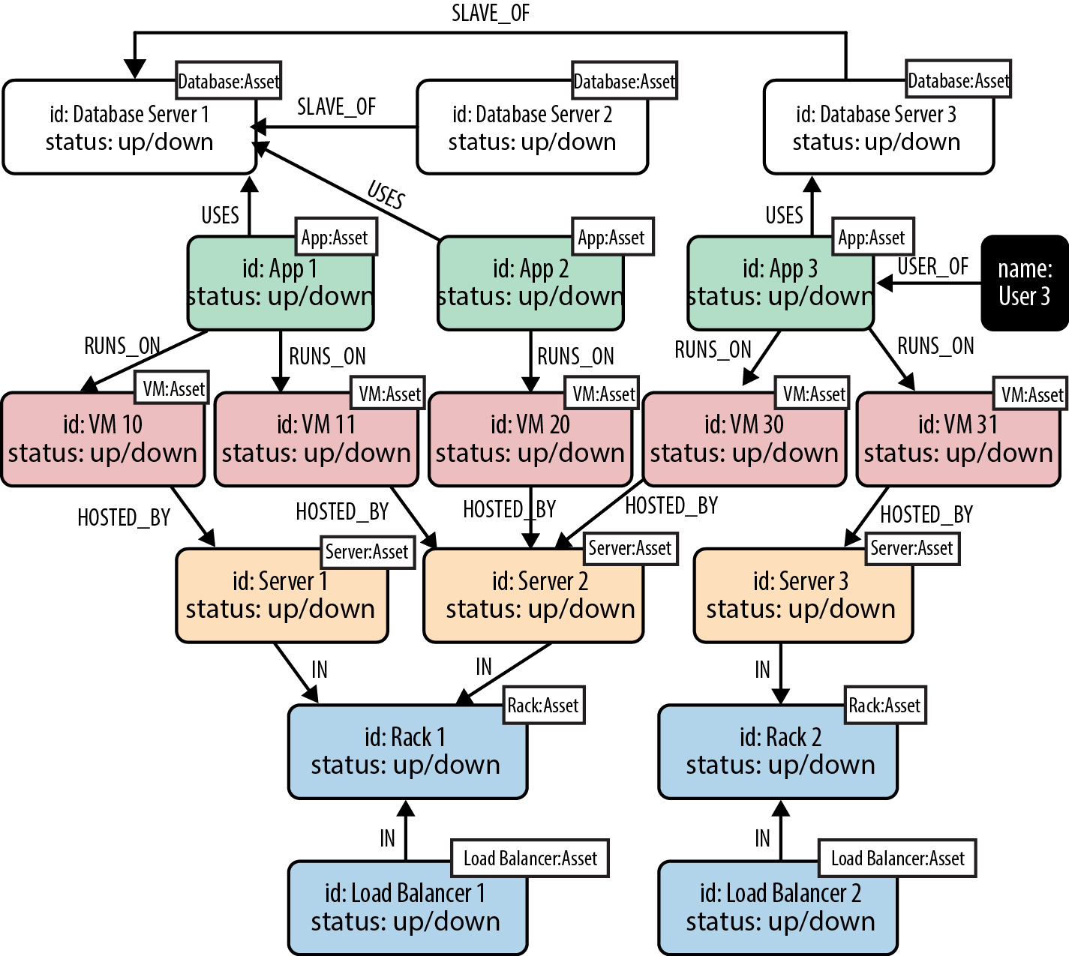
Data Modeling with Graphs
Graph Modeling in a Systems Management Domain

Slide 19
Data Modeling with Graphs
Test Graph Model
When a user reports a problem, we can limit the physical fault-finding to problematic network elements between the user and the application and the application and its dependencies.
In our graph we can find the faulty equipment with the following query:
MATCH (user:User)-[*1..5]-(asset:Asset) WHERE user.name = 'User 3' AND asset.status = 'down' RETURN DISTINCT asset
This allows us to match paths such as:
(user)-[:USER_OF]->(app)
(user)-[:USER_OF]->(app)-[:USES]->(database)
(user)-[:USER_OF]->(app)-[:USES]->(database)-[:SLAVE_OF]->(another-database)
(user)-[:USER_OF]->(app)-[:RUNS_ON]->(vm)
(user)-[:USER_OF]->(app)-[:RUNS_ON]->(vm)-[:HOSTED_BY]->(server)
(user)-[:USER_OF]->(app)-[:RUNS_ON]->(vm)-[:HOSTED_BY]->(server)-[:IN]->(rack)
(user)-[:USER_OF]->(app)-[:RUNS_ON]->(vm)-[:HOSTED_BY]->(server)-[:IN]->(rack) <-[:IN]-(load-balancer)

Slide 20
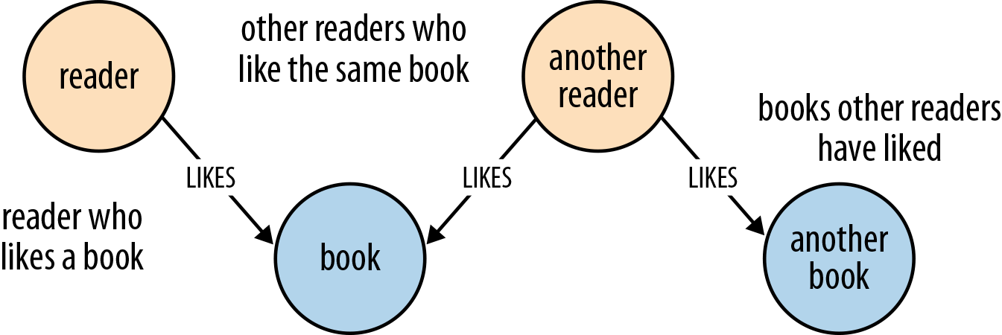
Building a Graph Database Application
Describe the Model in Terms of the Application’s Needs
Here’s an example of a user story for a book review web application:
AS A reader who likes a book, I WANT to know which books other readers who like the same book have liked, SO THAT I can find other books to read.
since Alice likes Dune, find books that others who like Dune have enjoyed:
MATCH (:Reader {name:'Alice'})-[:LIKES]->(:Book {title:'Dune’})<-[:LIKES]-(:Reader)-[:LIKES]->(books:Book)
RETURN books.title

Slide 21
Building a Graph Database Application
Nodes for Things, Relationships for Structure
Use nodes to represent entities—that is, the things in our domain that are of interest to us, and which can be labeled and grouped.
Use relationships both to express the connections between entities and to establish semantic context for each entity, thereby structuring the domain.
Use relationship direction to further clarify relationship semantics. Many relationships are asymmetrical, which is why relationships in a property graph are always directed. For bidirectional relationships, we should make our queries ignore direction, rather than using two relationships.
Use node properties to represent entity attributes, plus any necessary entity metadata, such as timestamps, version numbers, etc.
Use relationship properties to express the strength, weight, or quality of a relationship, plus any necessary relationship metadata, such as timestamps, version numbers, etc.

Slide 22
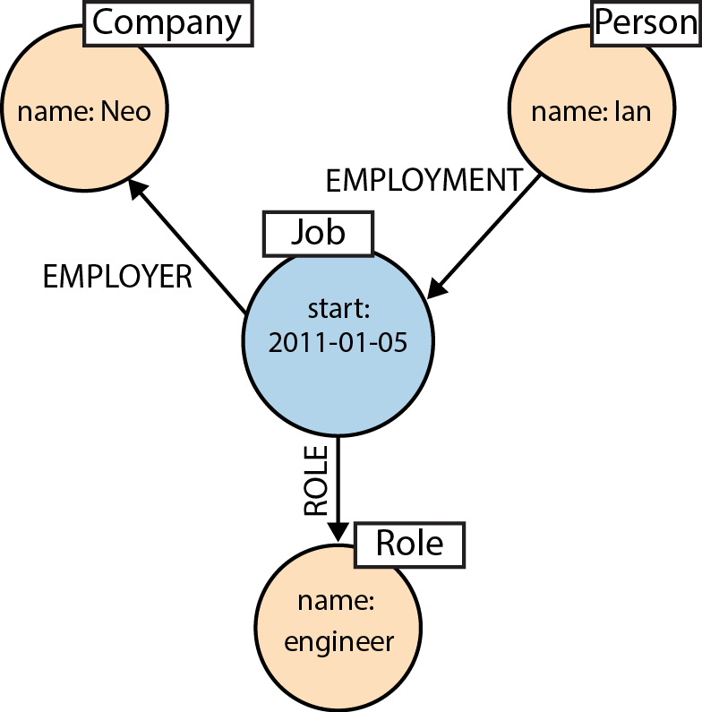
Building a Graph Database Application
Model Facts as Nodes
Employment
The Figure shows how the fact of Ian being employed by Neo Technology in the role of engineer can be represented in the graph.
CREATE (:Person {name:'Ian'})-[:EMPLOYMENT]-> (employment:Job {start_date:'2011-01-05'}) -[:EMPLOYER]->(:Company {name:'Neo'}),
(employment)-[:ROLE]->(:Role {name:'engineer'})

Slide 23
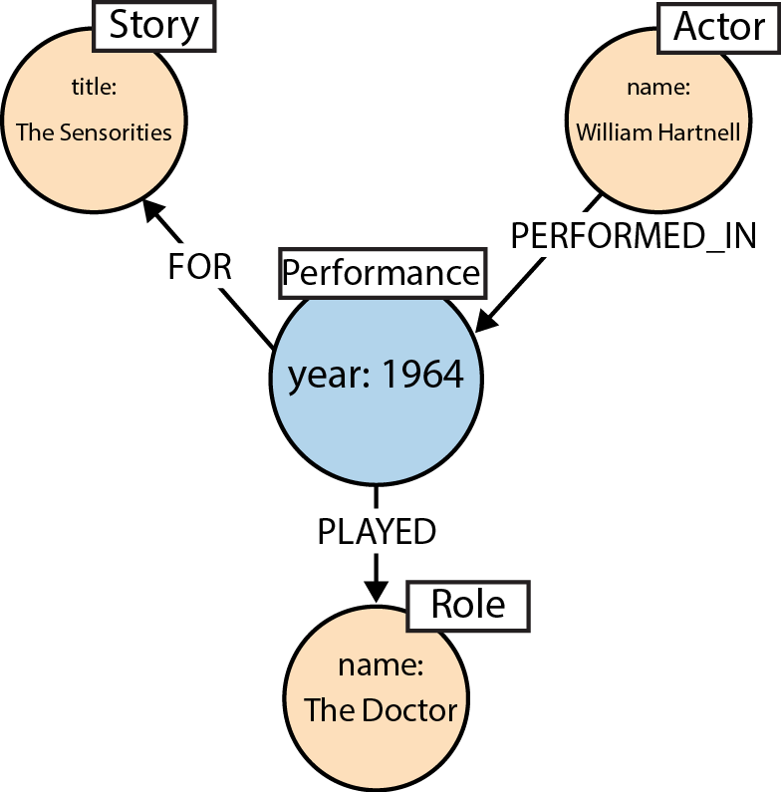
Building a Graph Database Application
Model Facts as Nodes
Performance
The Figure shows how the fact that William Hartnell played The Doctor in the story The Sensorites can be represented in the graph.
CREATE (:Actor {name:'William Hartnell'})-[:PERFORMED_IN]-> (performance:Performance {year:1964})-[:PLAYED]-> (:Role {name:'The Doctor'}),
(performance)-[:FOR]->(:Story {title:'The Sensorites'})

Slide 24
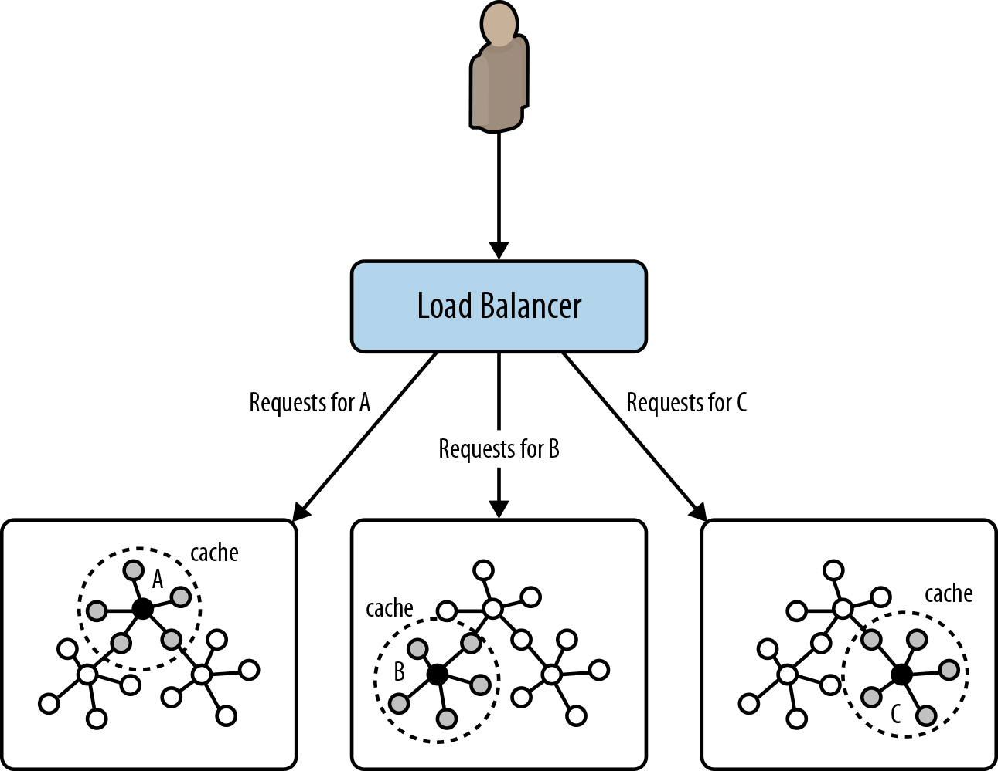
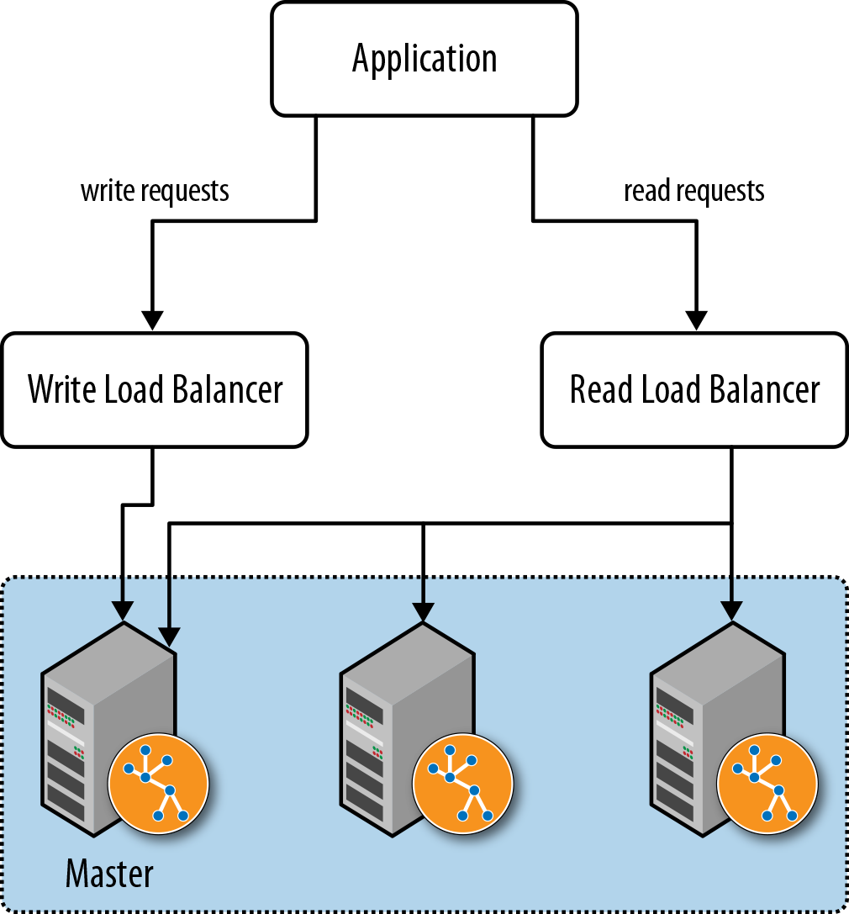
Building a Graph Database Application
Embedded versus Server
Most databases today run as a server that is accessed through a client library. Neo4j is somewhat unusual in that it can be run in embedded as well as server mode.
In embedded mode, Neo4j runs in the same process as our application.
Running Neo4j in server mode is the most common means of deploying the database today.
Cluster

Slide 25
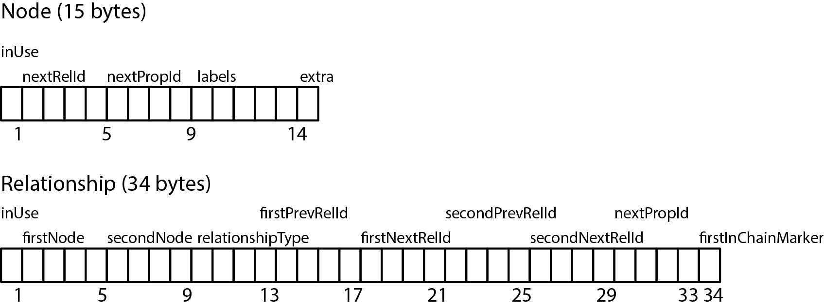
Graph Database Internals
Neo4j stores graph data in a number of different store files.
Each store file contains the data for a specific part of the graph (e.g., there are separate stores for nodes, relation‐ ships, labels, and properties).

Slide 26
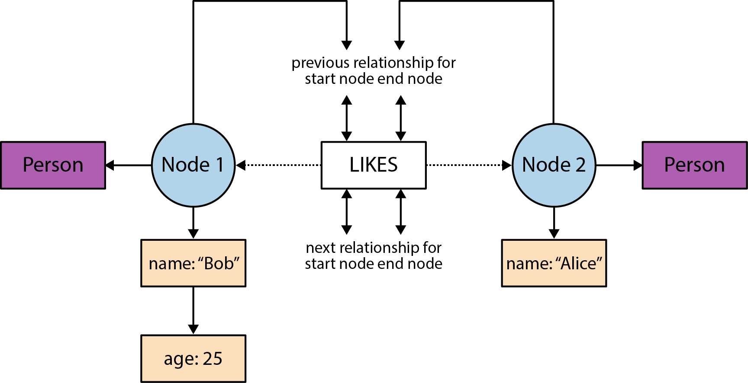
Graph Database Internals
Neo4j stores graph data in a number of different store files.
Doubly Linked Lists in the Relationship Store

Slide 27
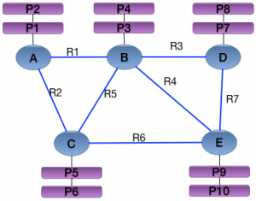
Graph Database Internals
Neo4j stores graph data

Slide 28
Graph Database Internals
Neo4j stores graph data
Node

Slide 29
Graph Database Internals
Neo4j stores graph data
relationship

Slide 30
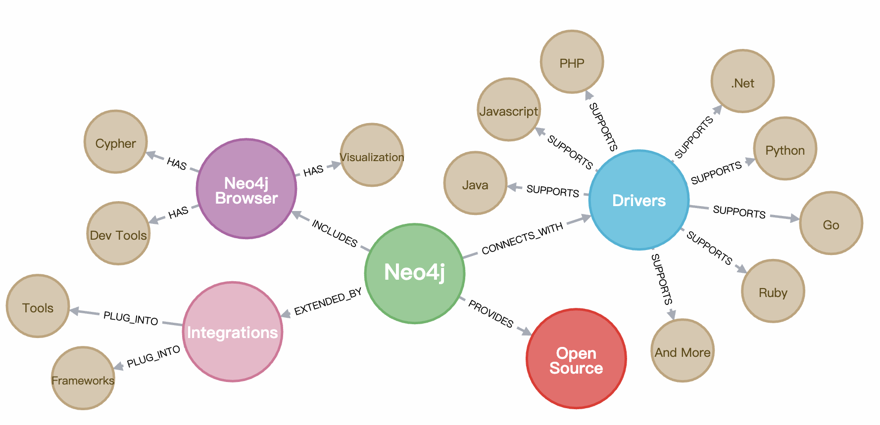
Neo4j

Slide 31
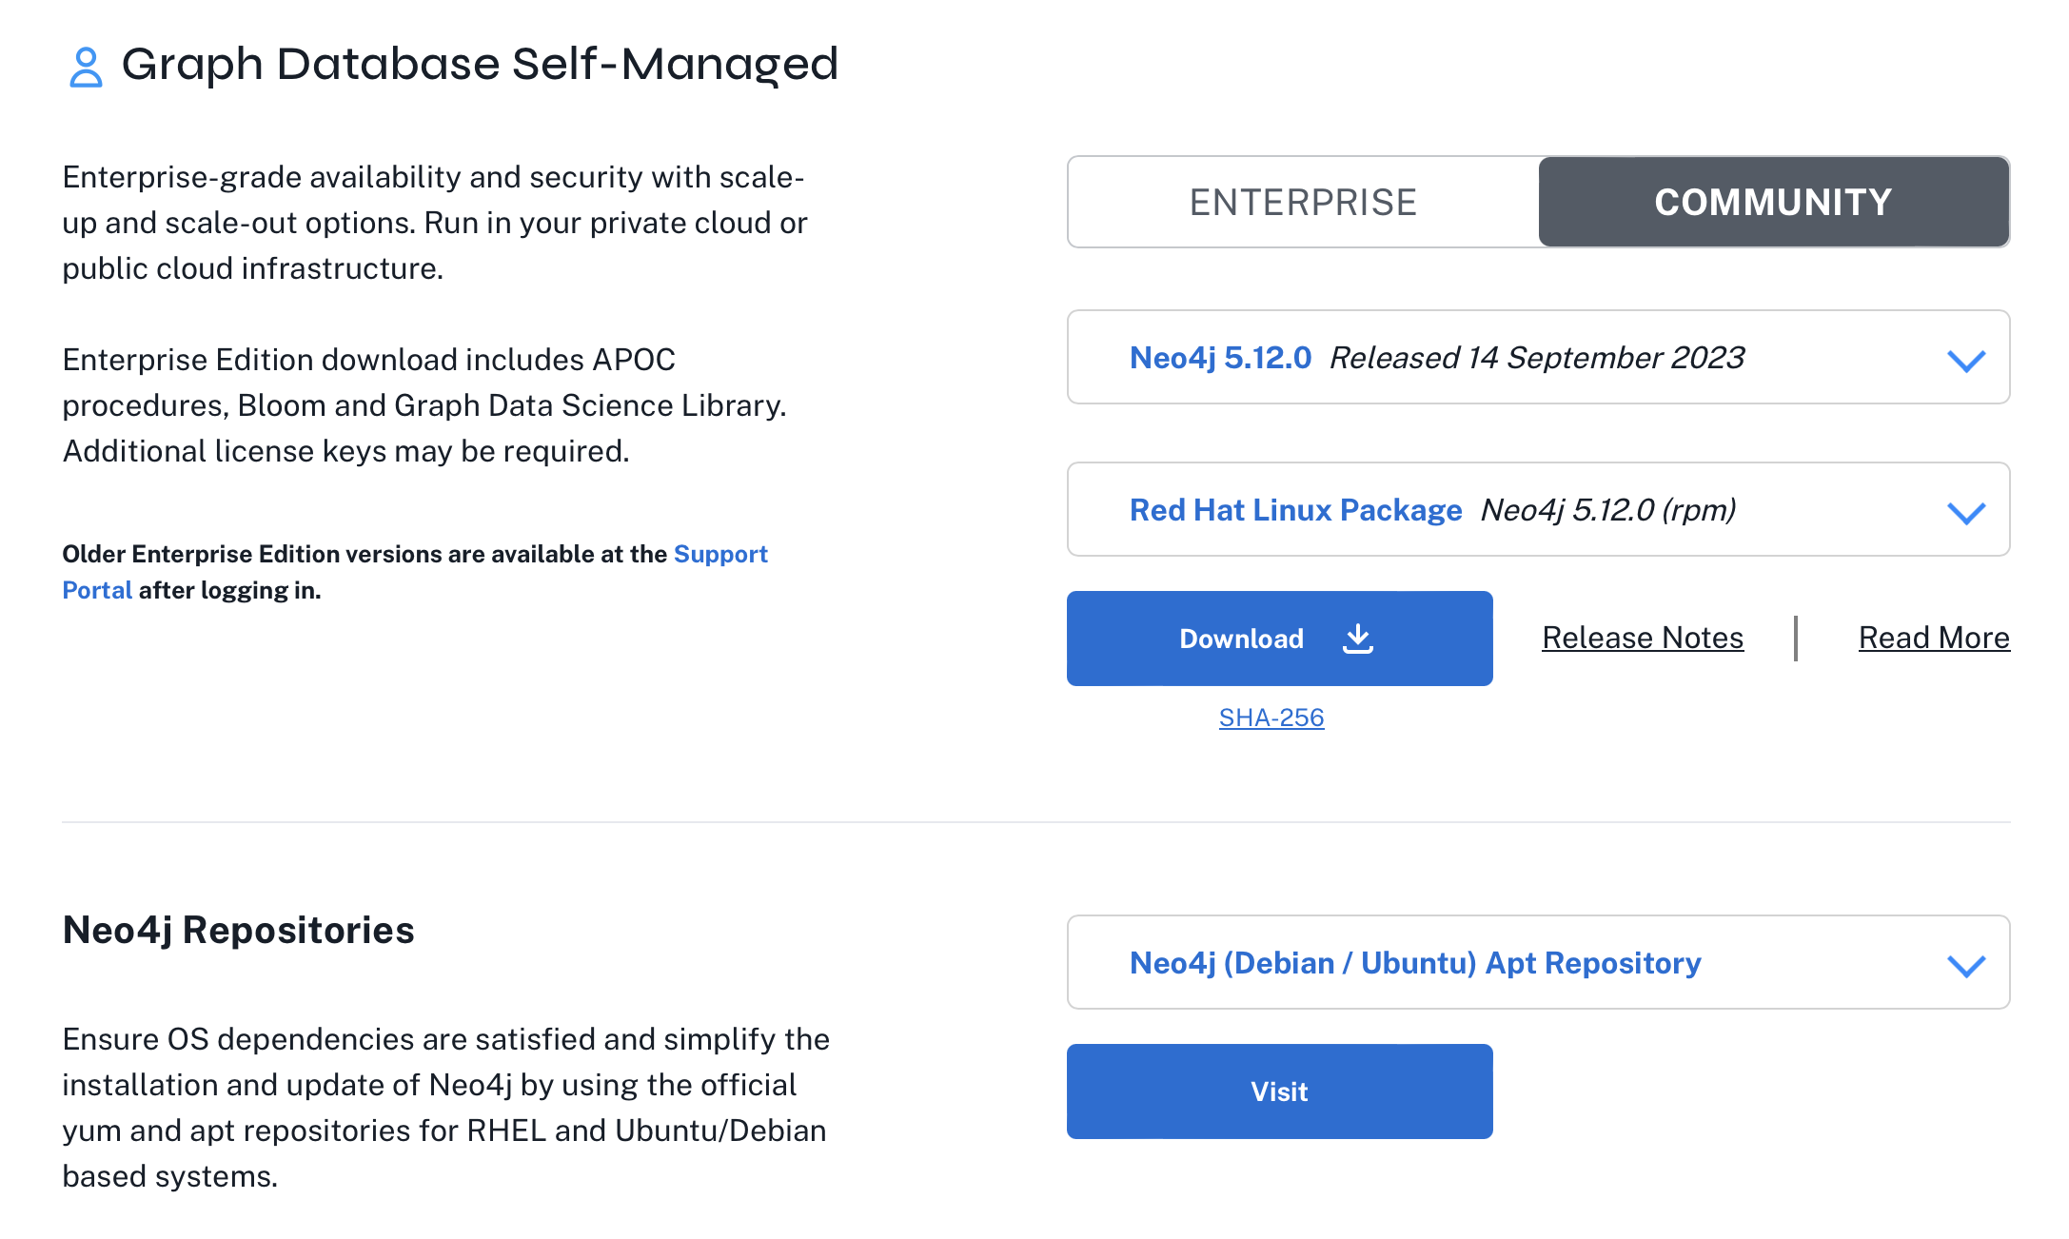
Download Neo4J Graph Database Self-Managed
https://neo4j.com/deployment-center/

Slide 32
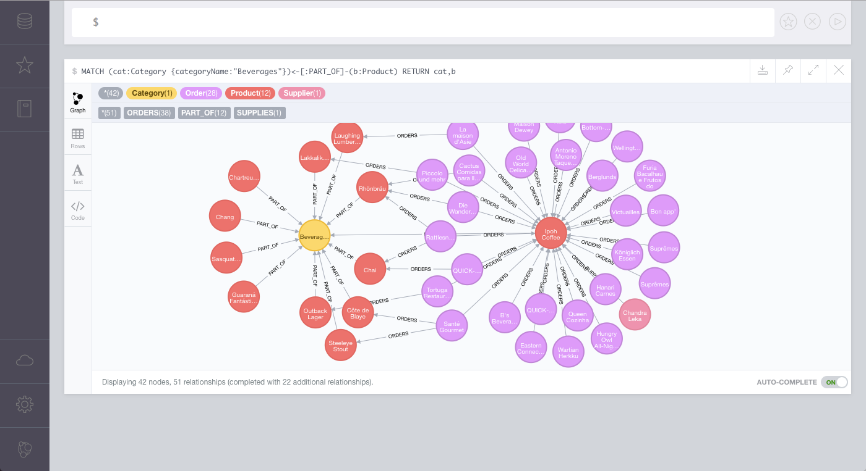
Install and Run Neo4j
Open up your terminal/shell.
Extract the contents of the archive, using: tar -xf <filecode>. For example, tar -xf neo4j-community-5.12.0-unix.tar.gz
Place the extracted files in a permanent home on your server. The top level directory is referred to as NEO4J_HOME.
To run Neo4j as a console application, use: <NEO4J_HOME>/bin/neo4j console
To run Neo4j in a background process, use: <NEO4J_HOME>/bin/neo4j start
Visit http://localhost:7474 in your web browser.
Connect using the username 'neo4j' with default password 'neo4j'. You'll then be prompted to change the password.

Slide 33
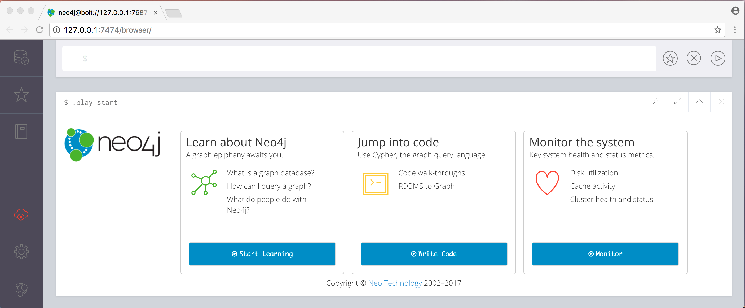
Install Neo4J
Start Up the Neo4j Browser
Visit: http://localhost:7474/

Slide 34
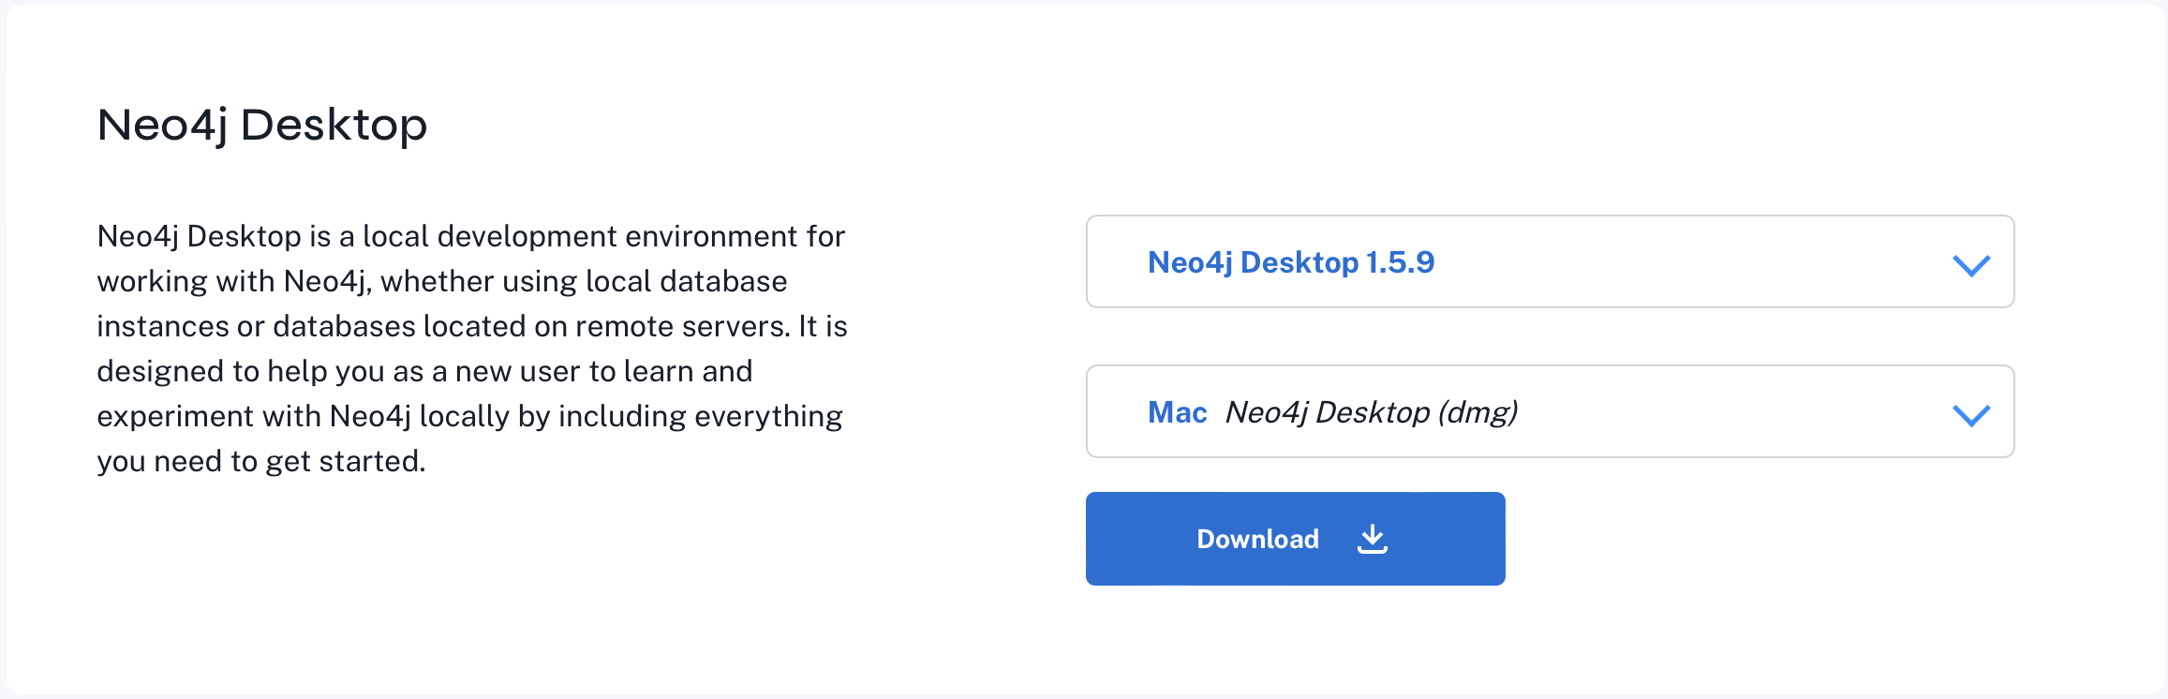
Download and Install Neo4J Desktop
https://neo4j.com/deployment-center/

Slide 35
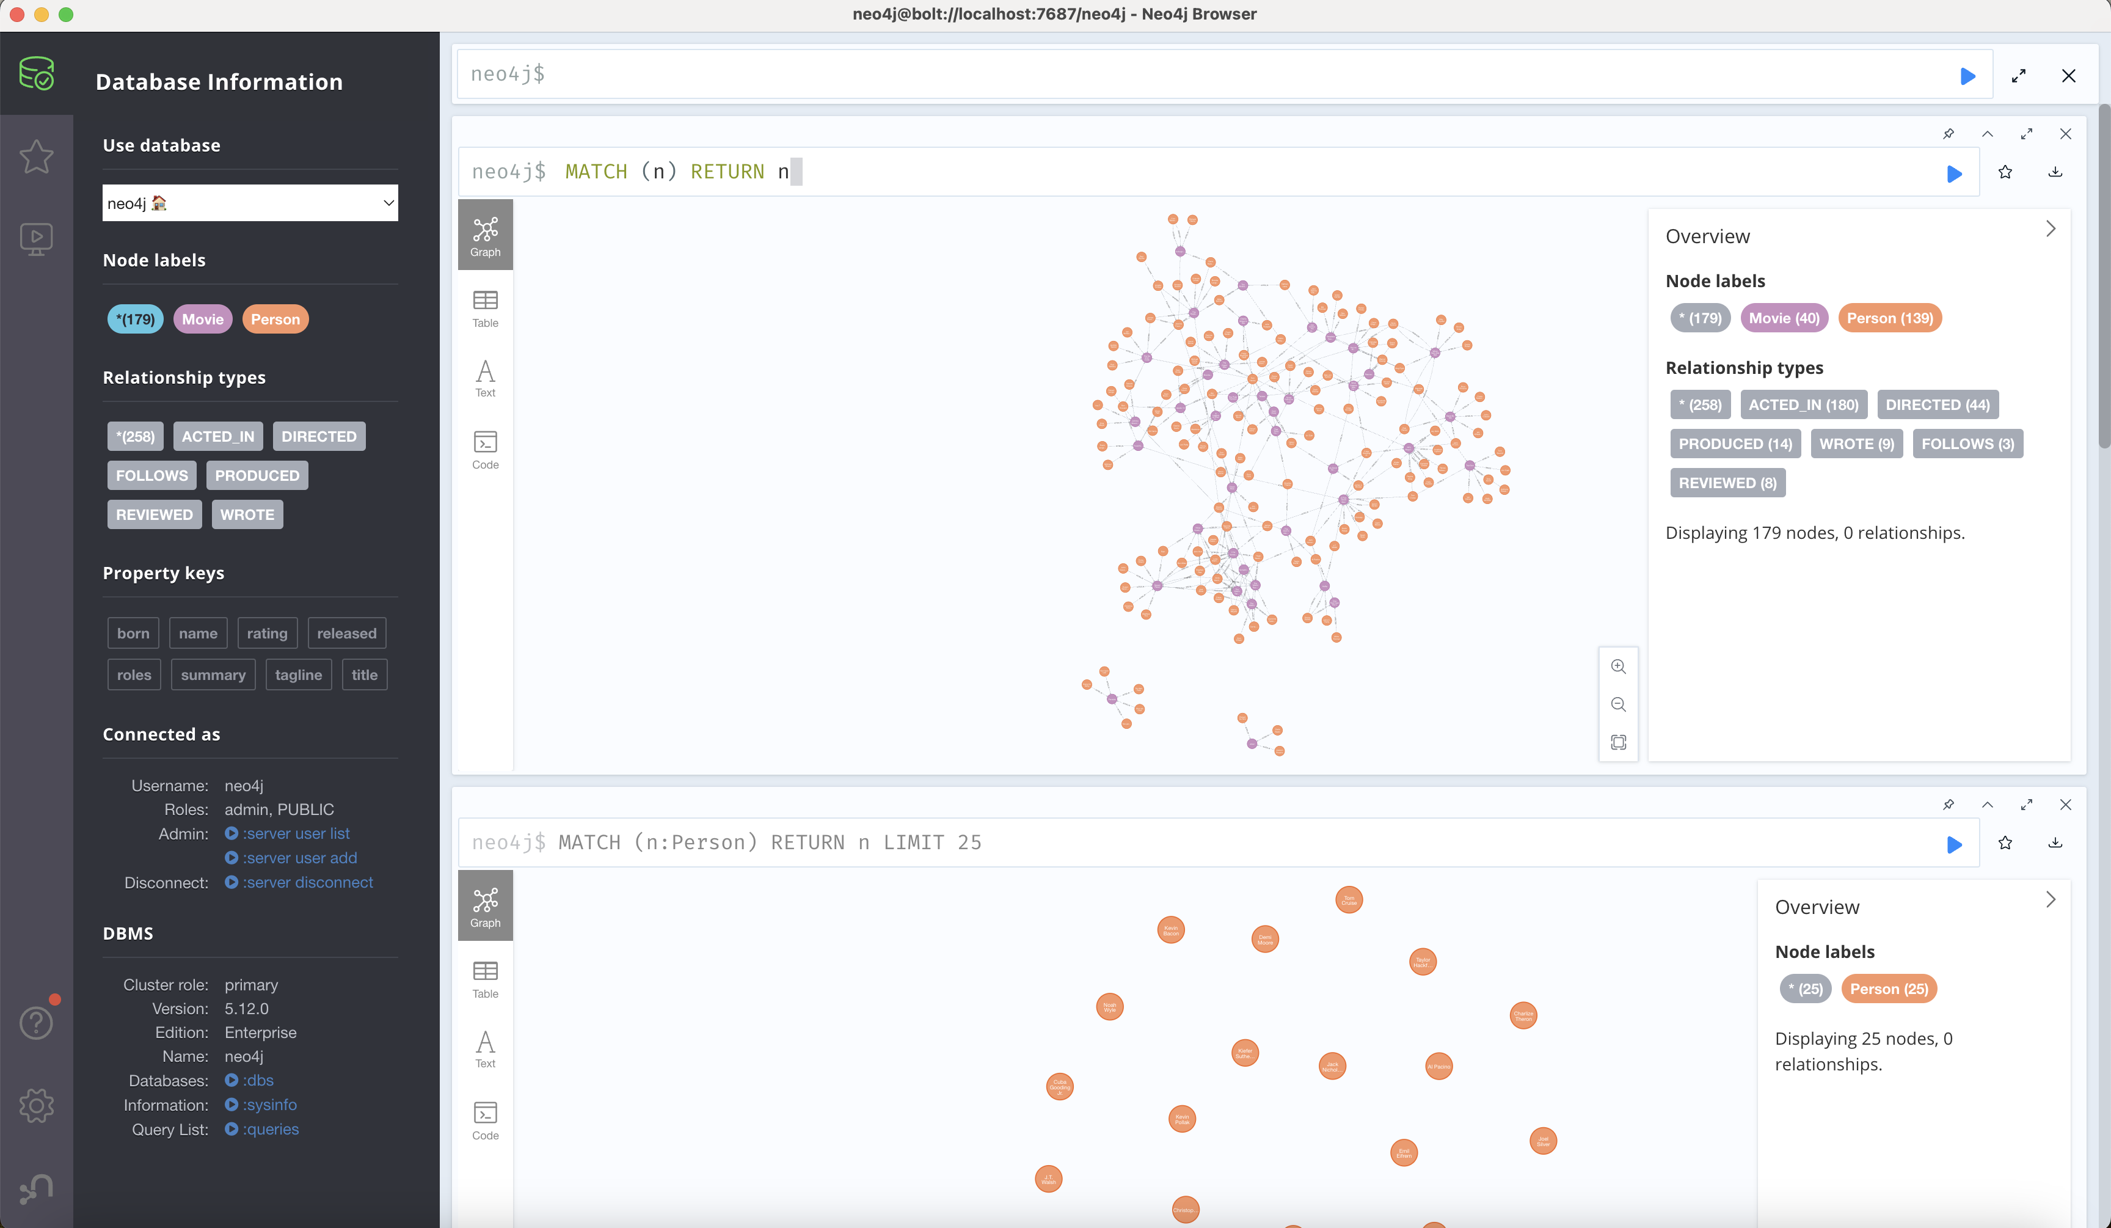
Download and Install Neo4J Desktop

Slide 36
Sample
pom.xml
<dependencies> <dependency> <groupId>org.springframework.boot</groupId> <artifactId>spring-boot-starter-data-neo4j</artifactId> </dependency> </dependencies>

Slide 37
Sample
public void worksWith(Person person) { if (teammates == null) { teammates = new HashSet<>(); } teammates.add(person); } public String toString() { return this.name + "'s teammates => " + Optional.ofNullable(this.teammates).orElse( Collections.emptySet()).stream() .map(Person::getName) .collect(Collectors.toList()); } public String getName() { return name; } public void setName(String name) { this.name = name; } }
Person.java
@Node public class Person { @Id @GeneratedValue private Long id; private String name; private Person() { // Empty constructor required as of Neo4j API 2.0.5 }; public Person(String name) { this.name = name; } @Relationship(type = "TEAMMATE") public Set<Person> teammates;

Slide 38
Sample
PersonRepository.java
public interface PersonRepository extends Neo4jRepository<Person, Long> { Person findByName(String name); List<Person> findByTeammatesName(String name);
@Query(value = "MATCH (person:Person) - [:TEAMMATE]->(teammate) - [:TEAMMATE]->(teammates)
WHERE person.name=$0 RETURN teammates") List<Person> findByTmofTm(String name);
}

Slide 39
Sample
Application.java
@SpringBootApplication @EnableNeo4jRepositories public class Se335316Neo4jsampleApplication { private final static Logger log = LoggerFactory.getLogger(Se335316Neo4jsampleApplication.class); public static void main(String[] args) throws Exception { SpringApplication.run(Se335316Neo4jsampleApplication.class, args); System.exit(0); }

Slide 40
Sample
greg = personRepository.findByName(greg.getName()); greg.worksWith(roy); greg.worksWith(craig); personRepository.save(greg); roy = personRepository.findByName(roy.getName()); roy.worksWith(craig); // We already know that roy works with greg personRepository.save(roy); // We already know craig works with roy and greg log.info("Lookup each person by name..."); team.stream().forEach(person -> log.info( "\t" + personRepository.findByName(person.getName()).toString())); List<Person> teammates = personRepository.findByTeammatesName(greg.getName()); log.info("The following have Greg as a teammate..."); teammates.stream().forEach(person -> log.info("\t" + person.getName()));
Application.java
@Bean CommandLineRunner demo(
PersonRepository personRepository) { return args -> { personRepository.deleteAll(); Person greg = new Person("Greg"); Person roy = new Person("Roy"); Person craig = new Person("Craig"); List<Person> team = Arrays.asList(greg, roy, craig); log.info("Before linking up with Neo4j..."); team.stream().forEach(person -> log.info("\t"
+ person.toString())); personRepository.save(greg); personRepository.save(roy); personRepository.save(craig);

Slide 41
Sample
Application.java
List<Person> teammates2 = personRepository.findByTmofTm(greg.getName()); log.info("The following have Greg as a teammate of teammates..."); teammates2.stream().forEach(person -> log.info("\t" + person.getName())); };
application.properties
spring.neo4j.uri=bolt://localhost:7687 spring.neo4j.authentication.username=neo4j spring.neo4j.authentication.password=reins2011!

Slide 42
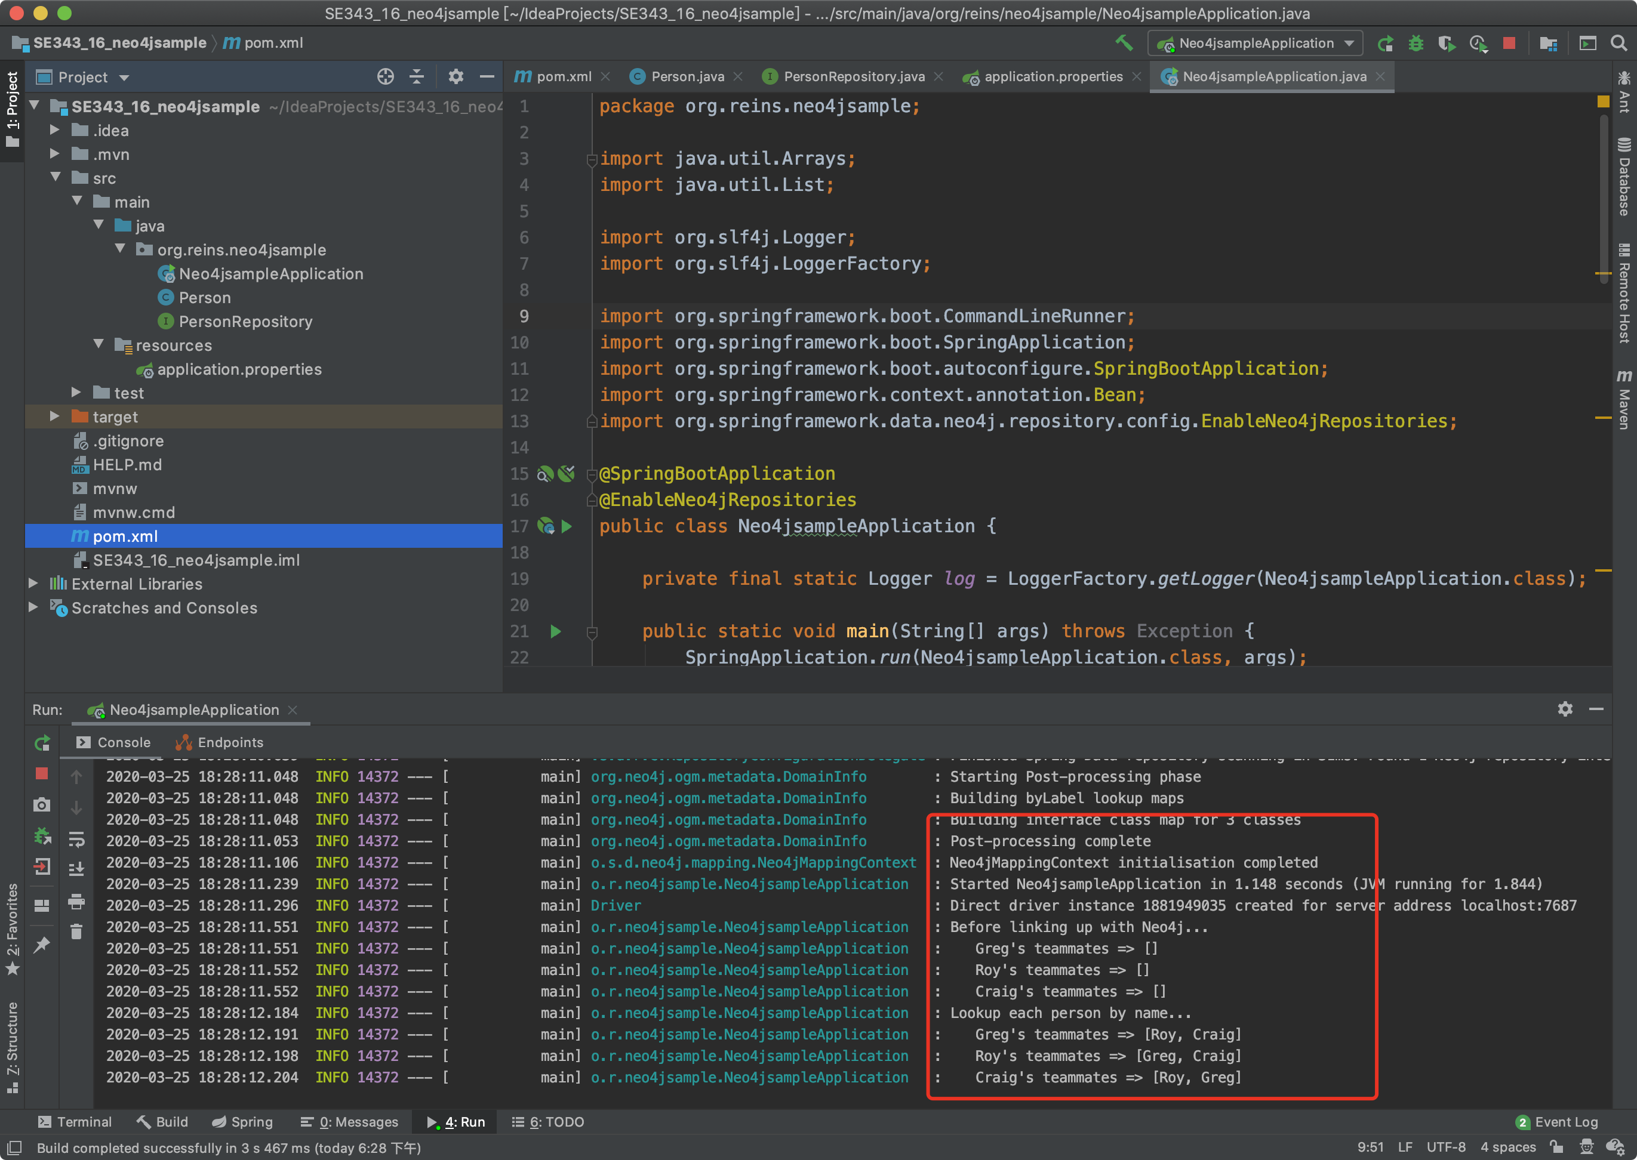
Sample

Slide 43
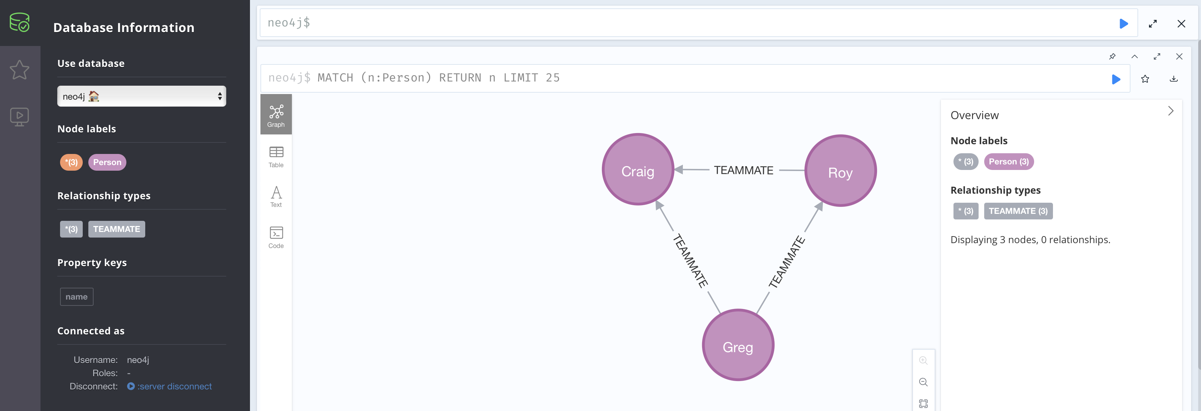
Sample

Slide 44
图计算概论
图数据上的分类问题
图粒度 vs. 节点粒度
节点特征 vs. 边特征
应用场景：
应用对象：社交网络、交易网络（边特征敏感）
应用任务：用户分类、异常行为检测…
图神经网络：
传统图神经网络未考虑边特征对于分类结果的影响
谱图理论：Graph Convolutional Network (GCN)
图注意力：Graph Attention Network (GAT)
仅有少数研究考虑了GNN在边特征上的拓展
仅可处理标签化的边特征（R-GCN)
仅将边特征视为权重进行处理（EGNN）
Node Attr
Edge Attr

Slide 45
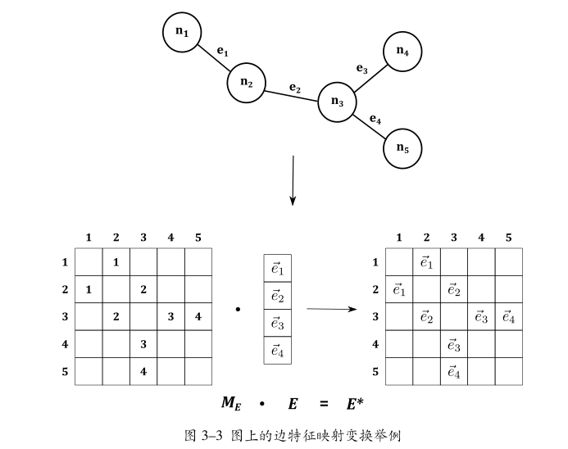
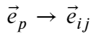
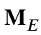
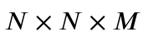
边特征映射
边特征的集合形式 → 邻接形式
边映射矩阵
维度大小为
第三维度：one-hot编码
可以预先构造
高维矩阵乘法

Slide 46
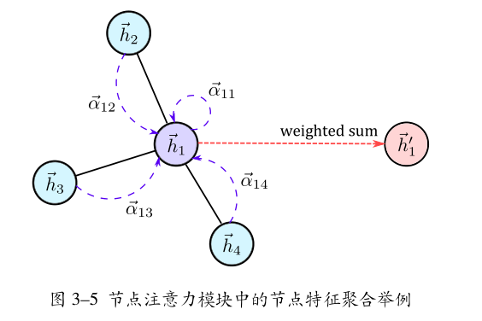
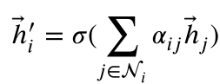
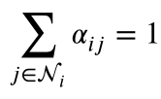
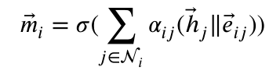
节点注意力模块
节点特征的聚合（参与后续迭代）
带有边特征的聚合（仅于融合层使用）

Slide 47
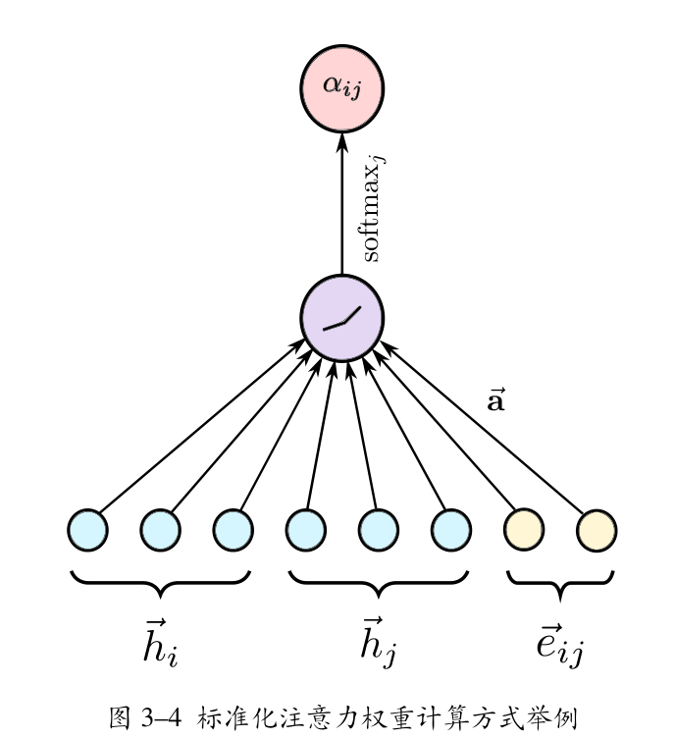
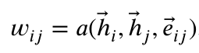
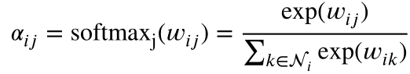
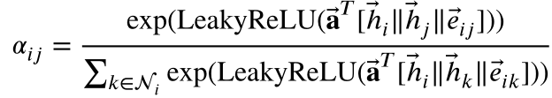
注意力权重计算
带有边特征的注意力权重计算
权重标准化 (softmax）
展开

Slide 48
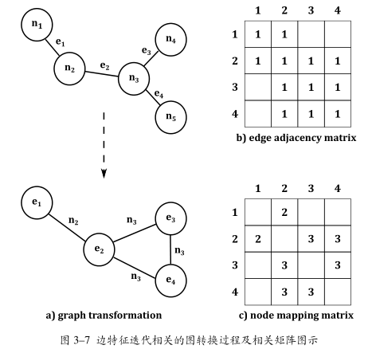
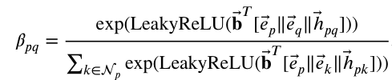
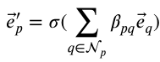
边注意力模块
边特征迭代的必要性
节点与边特征在迭代上的一致性
模型的对称性
点边互换策略
反转图
边邻接矩阵、节点映射矩阵

Slide 49
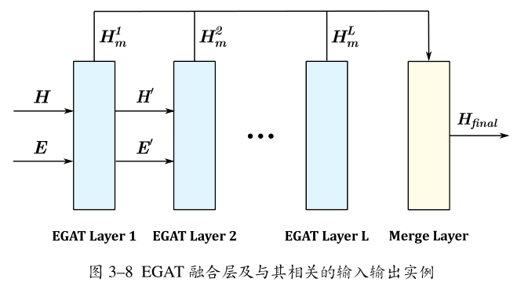
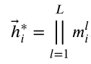
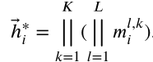
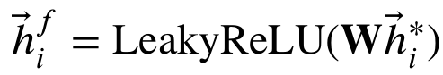
融合层
多尺度的特征融合策略
粗粒度的multi-head attention
维度压缩
softmax

Slide 50
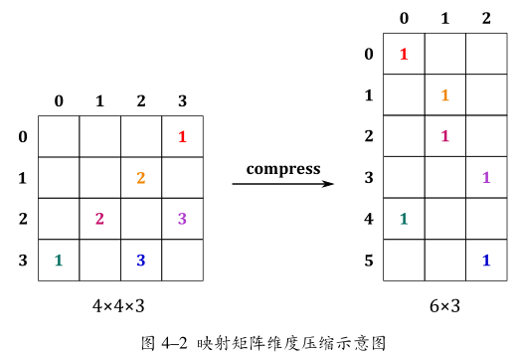

稀疏矩阵表示
邻接矩阵 & 映射矩阵
维度大小 ~ 图规模关系的非线性
内存与显存的局限性 & 计算的复杂性
稀疏矩阵表示
空元素数量 >> 非空元素数量
高维映射矩阵的初次压缩

Slide 51

总体流程与架构设计
根据实体关联数据构建图 -> 根据样例学习图中的模式 ->发现符合预期模式的数据，进行预警

Slide 52
边属性合并
Multi-Graph 多边合并
5
(5,15)
10
10
15
2,20
1,10

Slide 53

边属性合并
边属性 ->节点属性

Slide 54
图向量化
Graph -> Vector
data = {
time: 2019-01,
type: train,
data:
[
{
id: 1,
label: 1,
neighbors: [{
id: 1,
attr: {
layer: 0,
origin: [1.0, 1.0],
summable: [1.0, 2.0]
},
…
}]
},
…
]
}
时间
数据类型
数据
中心节点ID
中心节点标签
邻居节点
邻居节点ID
邻居节点原始属性
距中心节点距离
邻居节点可加属性 （边合并属性）

Slide 55

图向量化
GraphX (Pregel迭代计算)
设置传播层数上限
固定的邻居数量（Fixed-Size)
结果存储到MongoDB中 （Hiding Processing Latency）

Slide 56
References
Graph Databases: NEW OPPORTUNITIES FOR CONNECTED DATA
http://graphdatabases.com/?ref=blog&_ga=2.114598147.542116335.1524369358-1583480045.1524187154
Neo4j图数据库简介和底层原理
https://blog.csdn.net/bluejoe2000/article/details/72978478
The Neo4j Operations Manual v5
https://neo4j.com/docs/operations-manual/current/
Neo4j install
https://neo4j.com/docs/operations-manual/current/installation/osx/
https://neo4j.com/download-thanks/?edition=community&release=5.12.0
Accessing Data with Neo4j
https://spring.io/guides/gs/accessing-data-neo4j/
Spring Data Neo4j
https://neo4j.com/developer/spring-data-neo4j/
https://docs.spring.io/spring-data/neo4j/docs/current/reference/html/
NEO4J学习笔记
https://zhuanlan.zhihu.com/p/339923457

Slide 57

Thank You!

